Slide 1
California Housing
Eric Liu, Shayan Norouzi, Ly-Bach Truong, and Sicong Wang

Slide 2
The Big Question
If we took the top and bottom five percentiles of houses in California during the year 1990, in terms of median house value, and compared them to houses of the same standing that have been listed for sale within the last year in the same market, would there be a statistical difference between the two groups?

Slide 3
Data Sources
We used two datasets to find the answer to our question:
The first comes from Kaggle, an online community platform for data enthusiasts. This dataset is a modified version from data that was gathered by associate professor, Luis Torgo, from the University of Porto, whom of which had collected the data from the California Census of 1990.
We pulled our second source from the California Regional Multiple Listing Service (CRMLS), an industry-accepted information dissemination system, as a csv file and is available upon request.
https://www.kaggle.com/harrywang/housing#housing.csv

Slide 4
Exploration & Cleanup
Limitations of data:
Kaggle dataset is an extracted (but not cleaned) version of the California 1990 Census
Takes the median/total values of ‘block groups’; split up by latitude and longitude; therefore, exact values for each house are not included
CRMLS data only shows listings that are posted by real estate brokers; therefore, off-market listings are not represented in the data
As we sifted through our data for valuable insights, we came across several relationships and plotted them accordingly.

Slide 5
California Housing (1990)

Slide 6
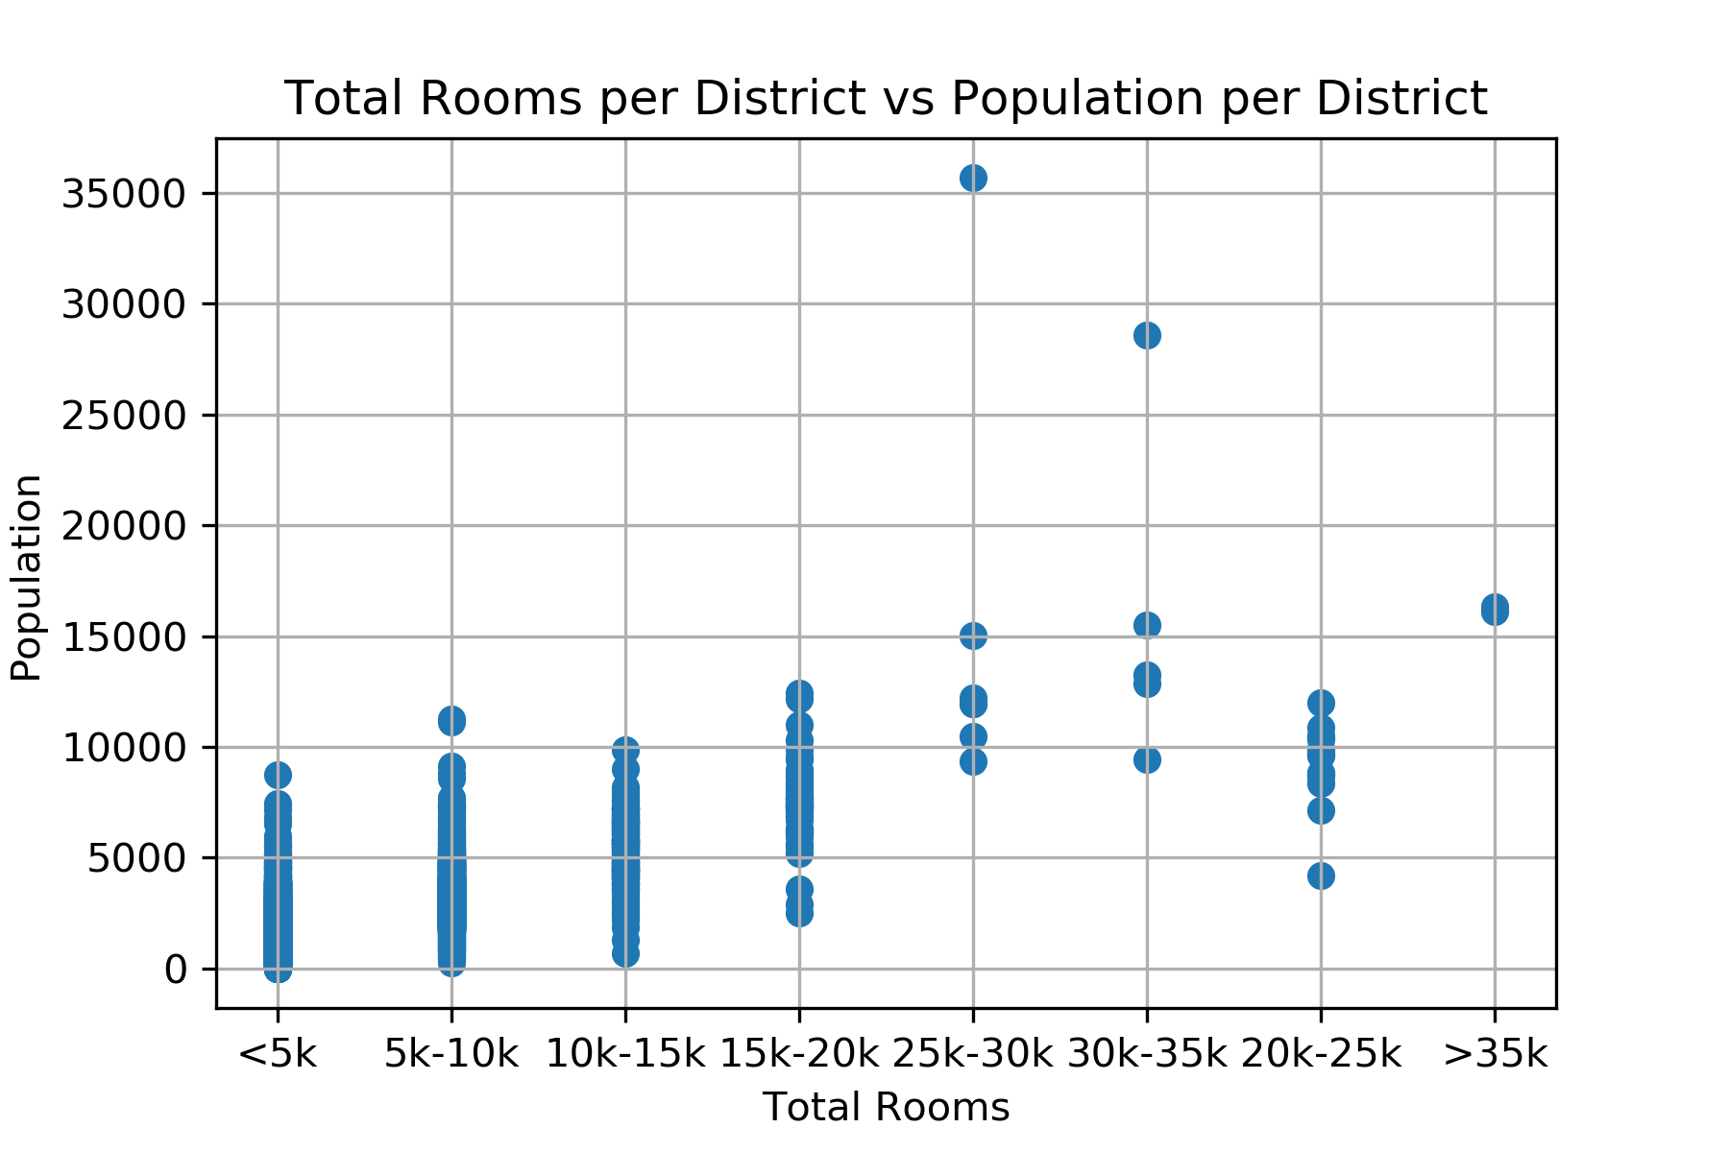
Notes:
The chart above depicts the frequencies for several ranges of number of total rooms per the district and is set against the total population of a district.
It is intriguing to see that there is a concentration of districts that have zero to twenty thousand rooms and populations from zero to thirteen thousand.

Slide 7
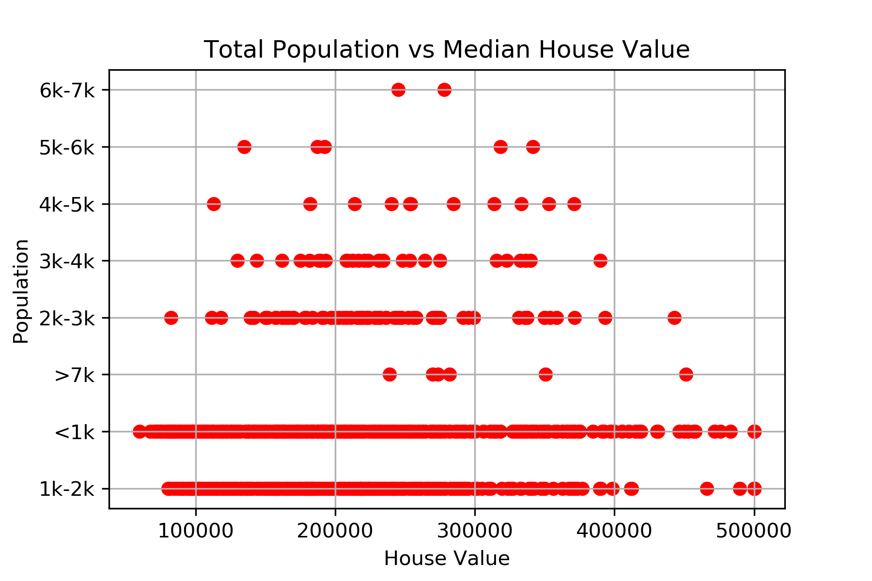
Notes:
From the plot above, we can see that there is a general concentration in districts with populations ranging from zero to two thousand people per district, in respect to houses that rank in the top five percentile in terms of median house value.
We can infer from this data that districts with this general range of population is ubiquitous, non-dependent of median house value.
Intriguingly, we can see that houses that are worth approximately five hundred thousand dollars can vary from small to large numbers of population.

Slide 8
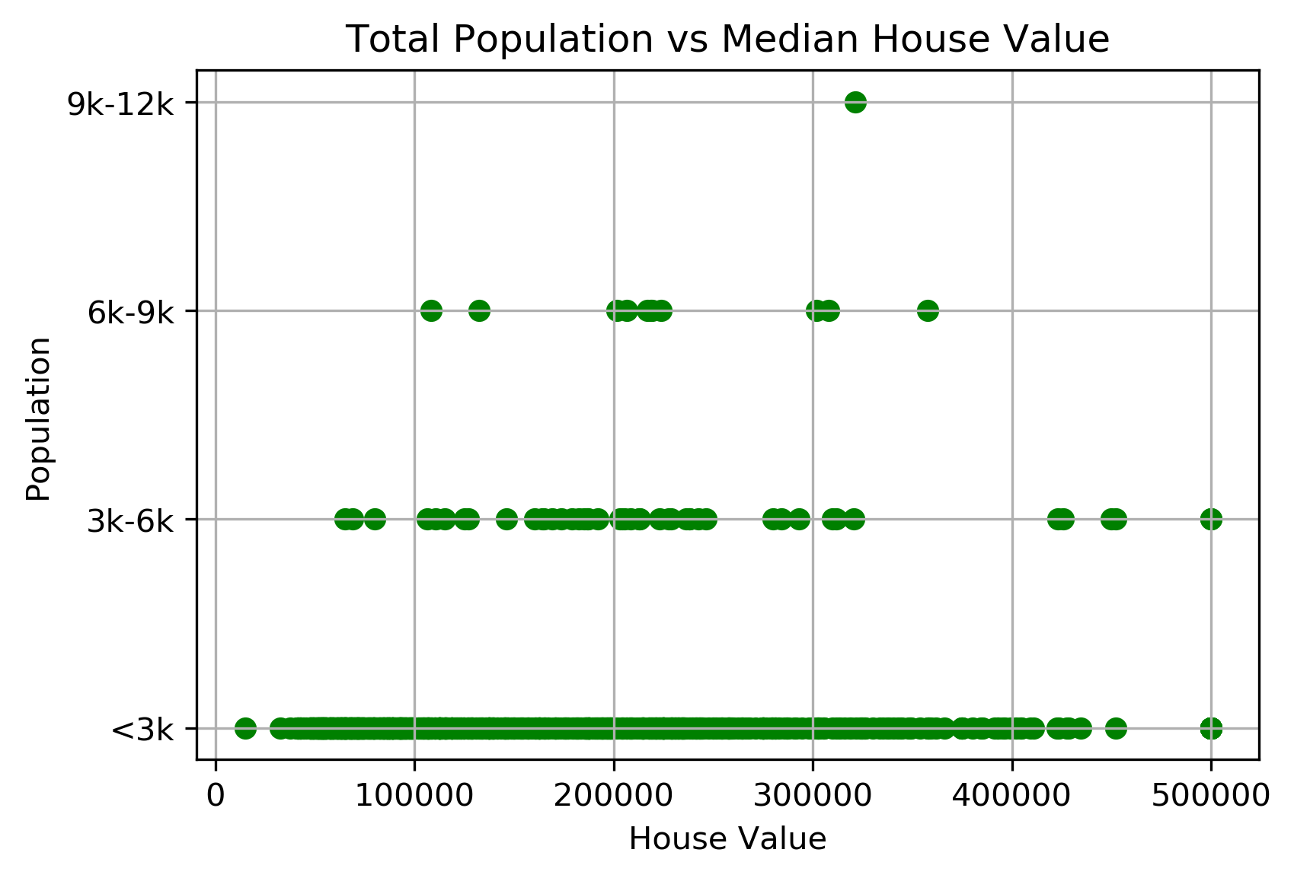
Notes:
From the plot above, we can see that there is a general concentration in districts with populations ranging from zero to three thousand people per district and from three to six thousand people per district, in respect to houses that rank in the bottom five percentile in terms of median house value.
We can infer from this data that districts with these general ranges of populations are ubiquitous and non-dependent of median house value.

Slide 9
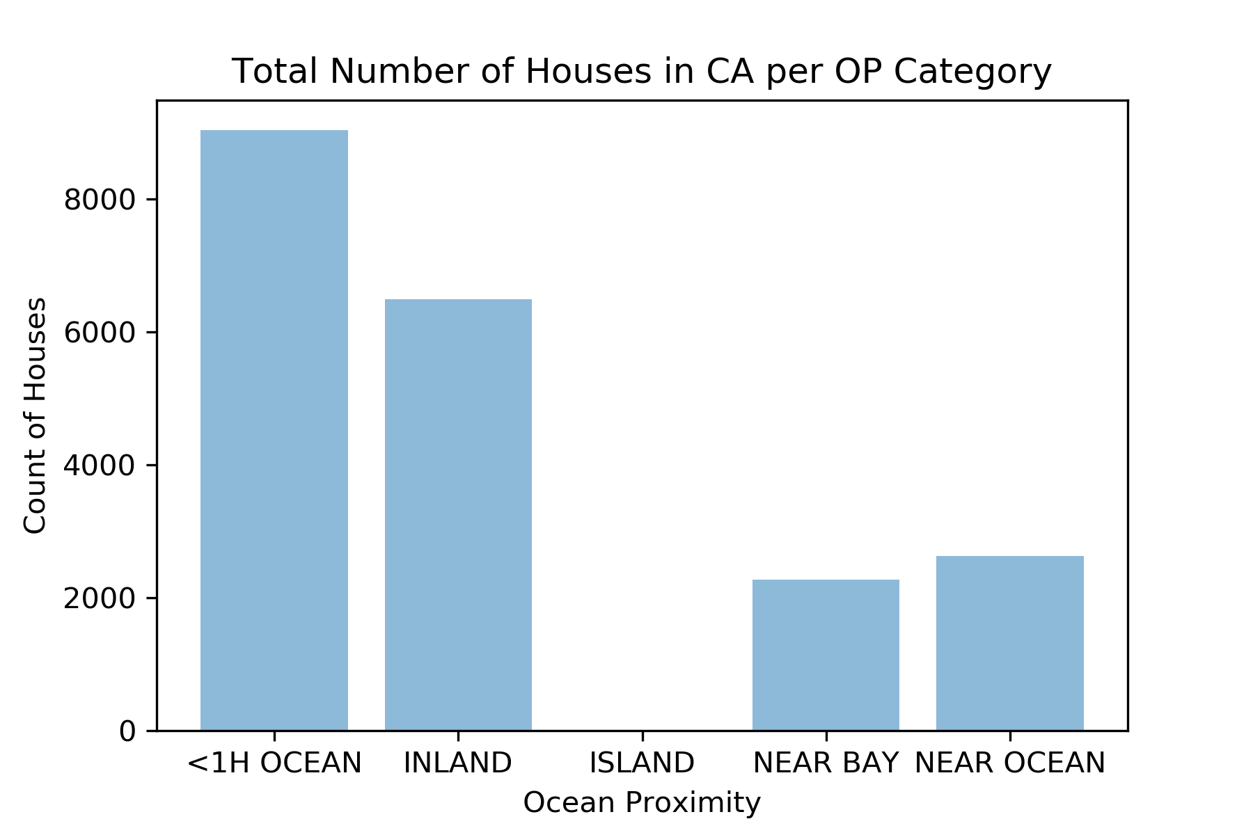
Notes:
The bar chart above depicts the total count of houses per each category.
We can see that most of the houses in California are either less than one-hour away from the ocean or are inland.
The chart also communicates that the majority of Californians lived less than one hour from the ocean during the 1990s.

Slide 10
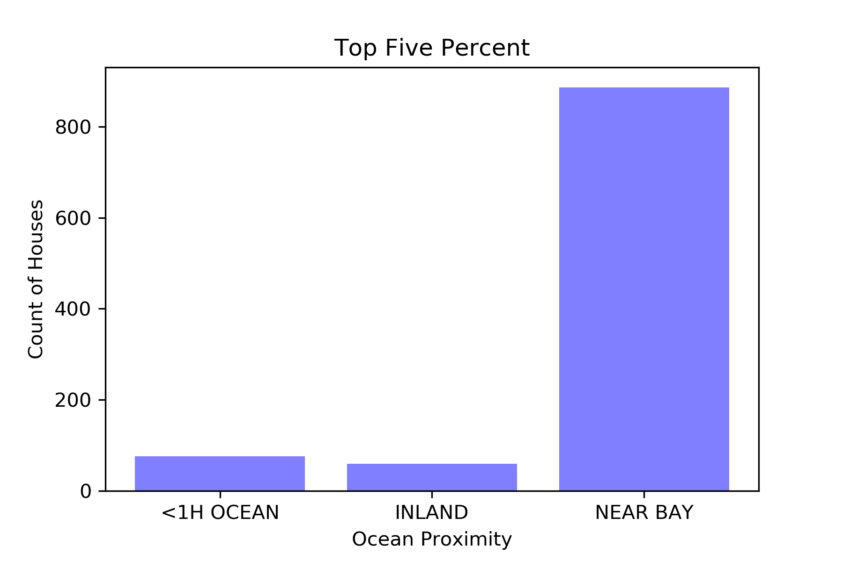
Notes:
This chart shows the total count of houses per OP category for houses in the top five percent, in terms of median house value.
The majority of these houses are near a bay area.

Slide 11
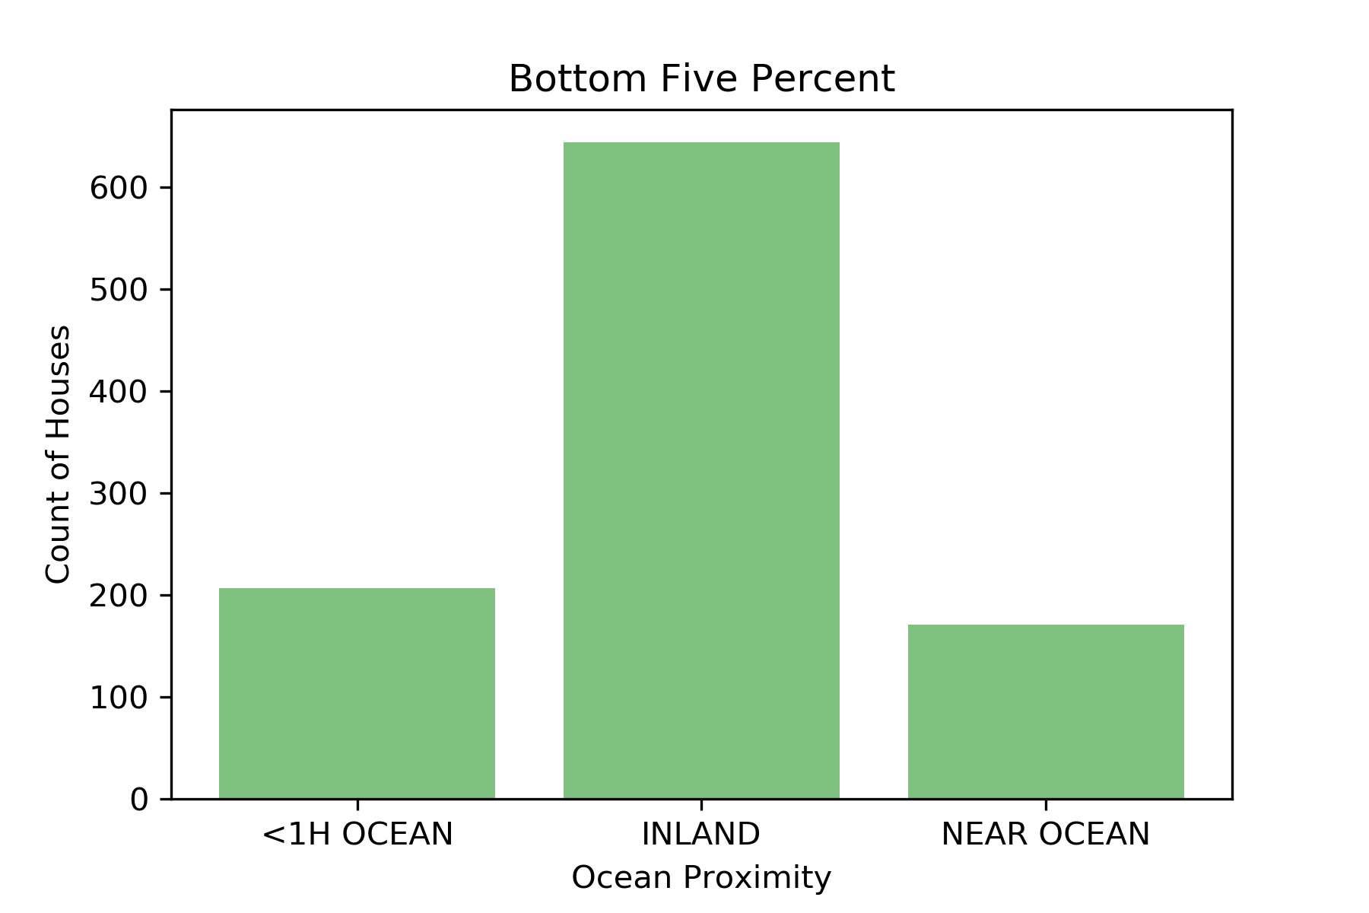
Notes:
This chart shows the total count of houses per OP category for houses in the bottom five percent, in terms of median house value.
The majority of these houses are inland, away from any body of water.

Slide 12
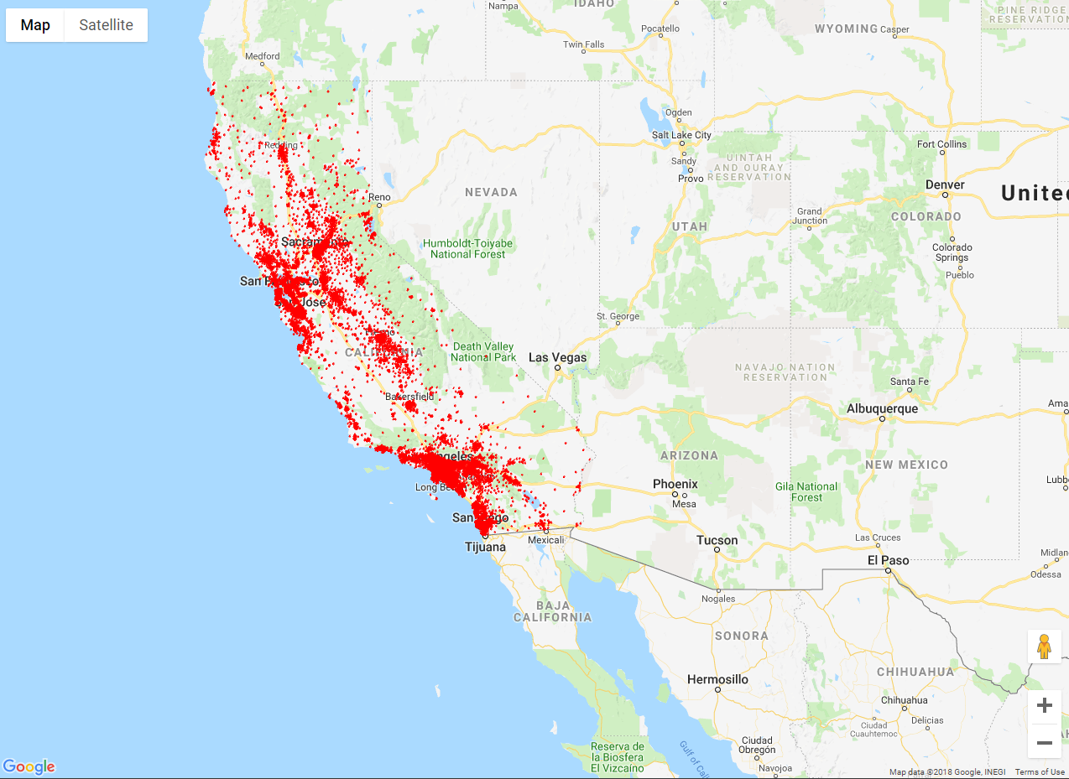
Notes:
All houses in CA 1990 Census
The visualization map of 1990 property transaction described the distribution of sales was not only focus on three major cities, LA, SF and SD, but also has a lot of records in inland area between NorCal to Socal , such as bakersfield.

Slide 13
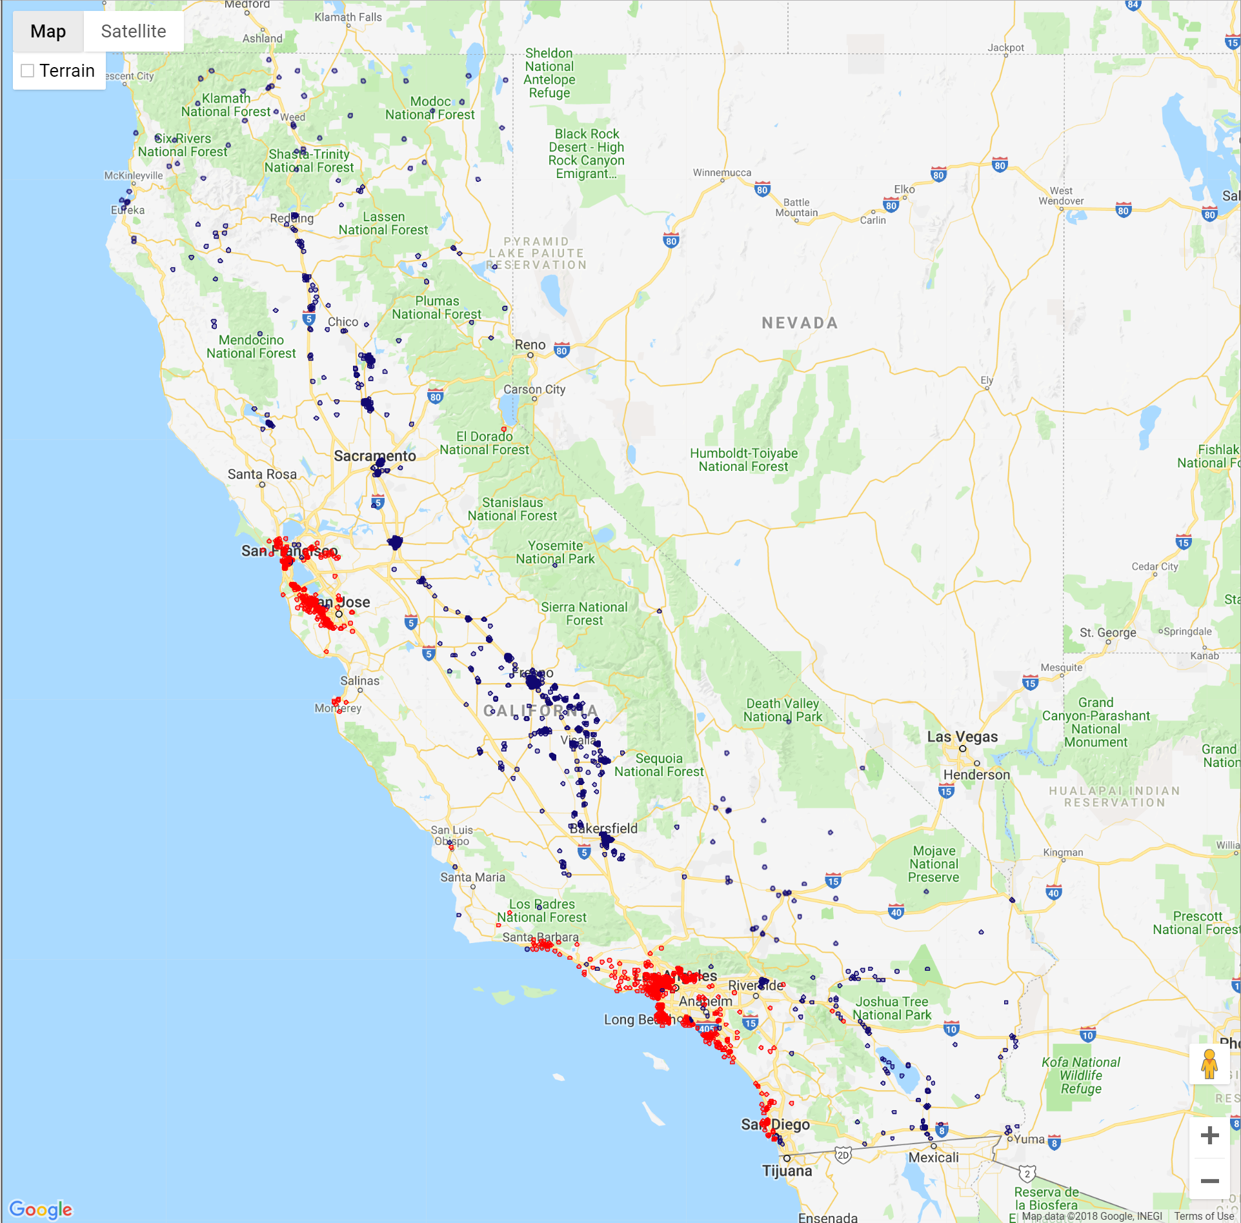
Notes:
Shows top and bottom 5% (red is top 5, blue is bottom 5) of houses in California, in respect to its median house value.
Based on 20k closed deal in 1990, the top 5% transaction was more closed to oceanside, and bot 5% transaction was in inland area of California.

Slide 14
Current Housing (2018)

Slide 15
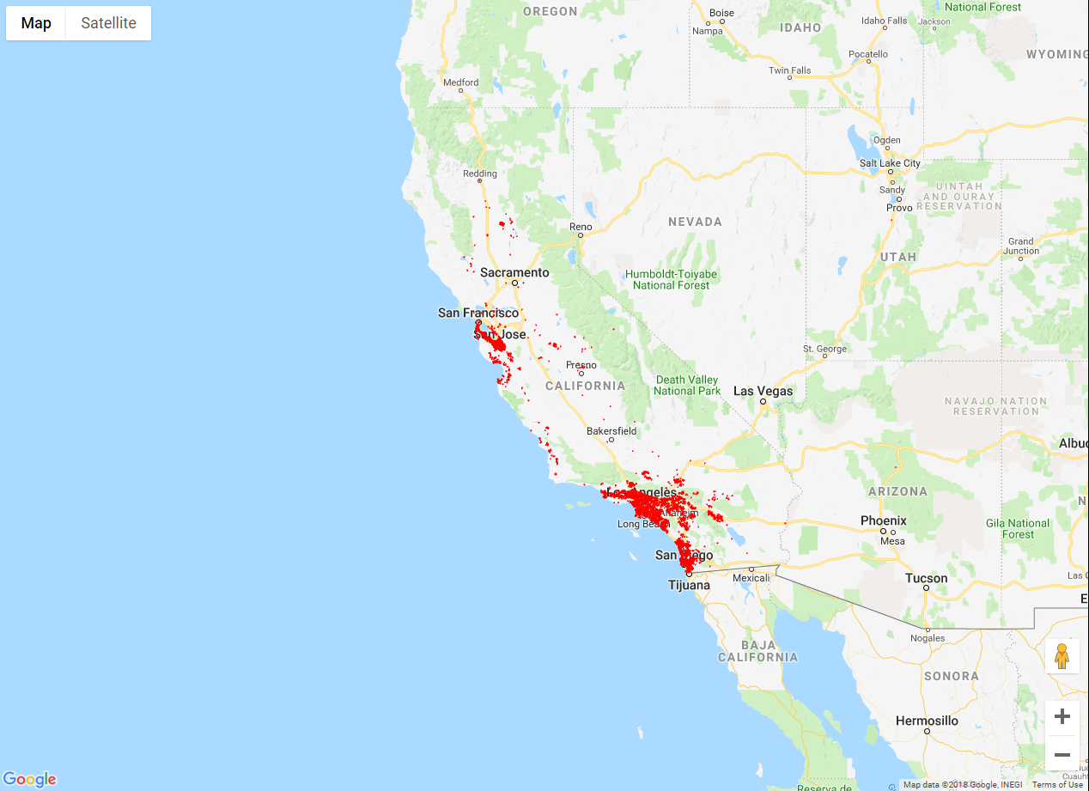
Notes:
All houses for sale in CA within last year
The Visualization map of 2018 property transaction described the distribution of sales was more focus on three major cities, LA, SF and SD, Which represents trends driven by rapid urbanization.

Slide 16
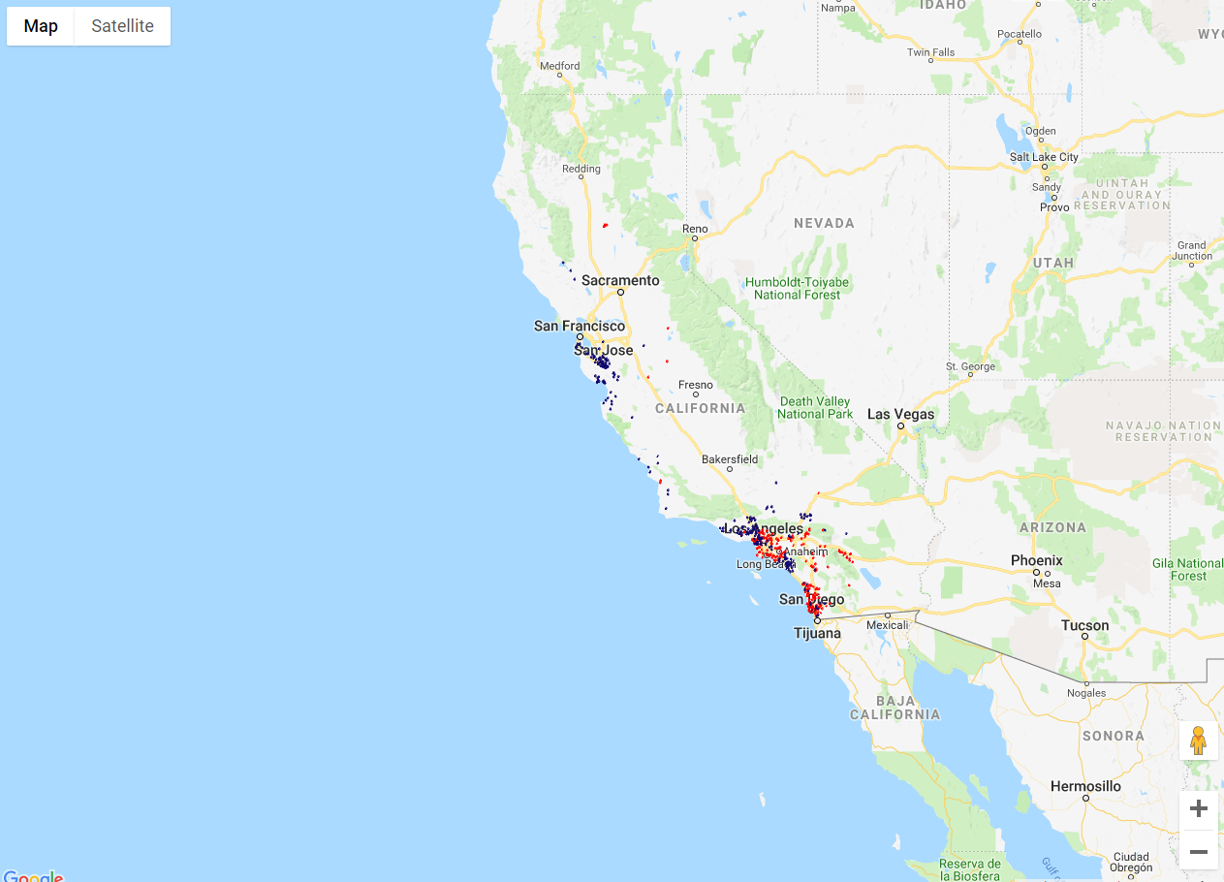
Notes:
Top and bot 5
houses for sale within last year
According to the gmplot generated, the sales of distribution of top 5 and bot 5 are more specifically states detail of urban are changing. SoCal has more closed deal of top 5 compared than NorCal. Ventura and Southern Orange county was lower than LA county and San Diego County from last year transaction detail.

Slide 17
T-Test Analysis
T-Test without normalization on 1990 house price and 2018 house price gives us a p-value: 2.306824488018087e-15. Which shows that there’s significant difference between two dataset, meaning the distribution of house prices are not similar.

Slide 18
Conclusion
From what we have found, there is a statistical difference between the two data sets, meaning that the same factors that affected the prices of houses in California during the year of 1990 are very unlikely to hold the same weight in determining the prices of houses in California in the present day.
Limitations of our conclusion:
Size and location of 2018 dataset
Population density.
Economic development by geographic distribution.
Housing age influenced by appreciation and depreciation factor.

